Slide 1

Bridging the Gap between Industry and Academia
Research Based Training

Slide 2
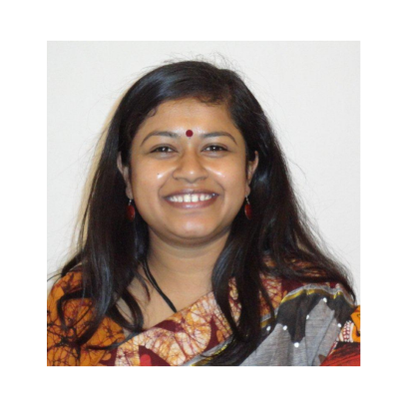
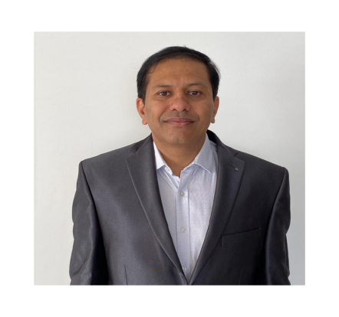

Meet The Directors
Ekata Mehul
Mr. Ketan Manvar
Principle Director
Director
Ekata Mehul, Director and CEO – Blazing Arrows Pvt. Ltd.; 25 years of experience in Industry & Academia; Board of Studies for various Universities; Ph. D. (Wireless Sensor Networks) (Education); M. Tech (ICT). B. Tech. (Comp.). Patent – “digital metering using Zigbee Technology’”, chapters in Books, Papers Publications. Nominated as “Women Entrepreneur Gujarat by GESIA”; IVLP Alumni in US for ‘Women in Technology”; “Traveler” for Arkansas state, US. Subject Matter Expert and Master Trainer – ESSCI, SSC NASSCOM. Executive member for “Computer Society of India, Baroda Chapter”, Core Committee in Vadodara HR Forum, life member for NASSCOM, ISTE, IETE. Director for “Women in Big Data, India”. An Educator & Blissful Human being
Ketan Manvar Director and CEO of Reliable Control Systems Pvt. Ltd, Orena Solusions; with 20Years of experience in the field of Design, Development and Manufacturing of Instrumentation Product For Automation and Control, With 150 Corporate Clients, Currently Running Relcon Systems, Unitech Technocrates Pvt. Ltd, Touch Controls.
Completed Bachelor Engineering Degree in Instrumentation and Controls from DDIT.
Focused on New Technology development in the field of automation and control.

Slide 3
Introduction SuiteCRM
SuiteCRM is a software fork of the popular Customer Relationship Management (CRM) system SugarCRM, developed and maintained by SalesAgility. It is a free and open source alternative application. It was released on October 21, 2013 as version 7.0.

Slide 4
Overview
What is SuiteCRM? And why it is Used?
System Architecture of SuiteCRM?
What is Lead?
SuiteCRM for Orena
Creating form For Recruitment
Creating Form For Training

Slide 5
What is SuiteCRM? And why it is Used?
Enhancing the skill set of people is the main goal.
SuiteCRM is a software fork of the popular Customer Relationship Management (CRM) system SugarCRM, developed and maintained by SalesAgility.
SuiteCRM is an open source Customer Relationship Management (CRM) software solution that provides a 360-degree view of your customers and business. Making it easy for your Sales, Marketing and Customer Service departments to discover key information that will help you grow, retain and delight your customers.

Slide 6
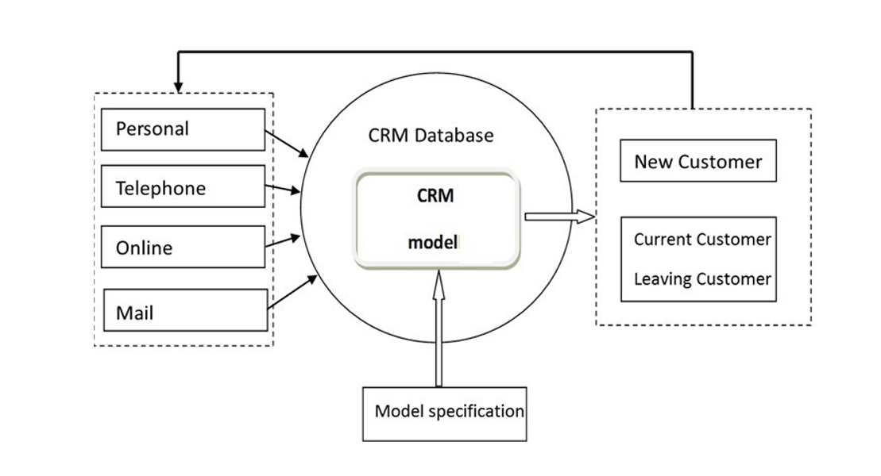
System Architecture of SuiteCRM?
Use Case for SuiteCRM

Slide 7
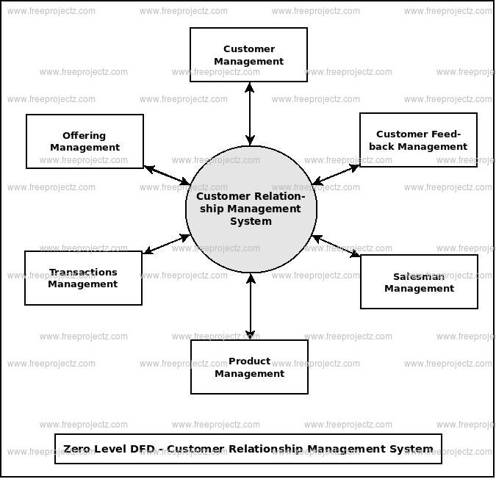
Dataflow Diagram of SuiteCRM

Slide 8
What is Lead?
In SuiteCRM a Lead is an unqualified contact usually generated from some form of marketing related event, for example it could be a person that has filled out a form on your website or someone that you met at a trade show and you are not sure yet if they have buying authority.

Slide 9
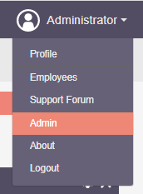
SuiteCRM for Orena
Creating Form For Training.
First we have to change the field name as per requirement.
The Procedure to Create Training form is :-
Step:-1 On top Right hand side of Dashboard
Administrator -> Admin

Slide 10
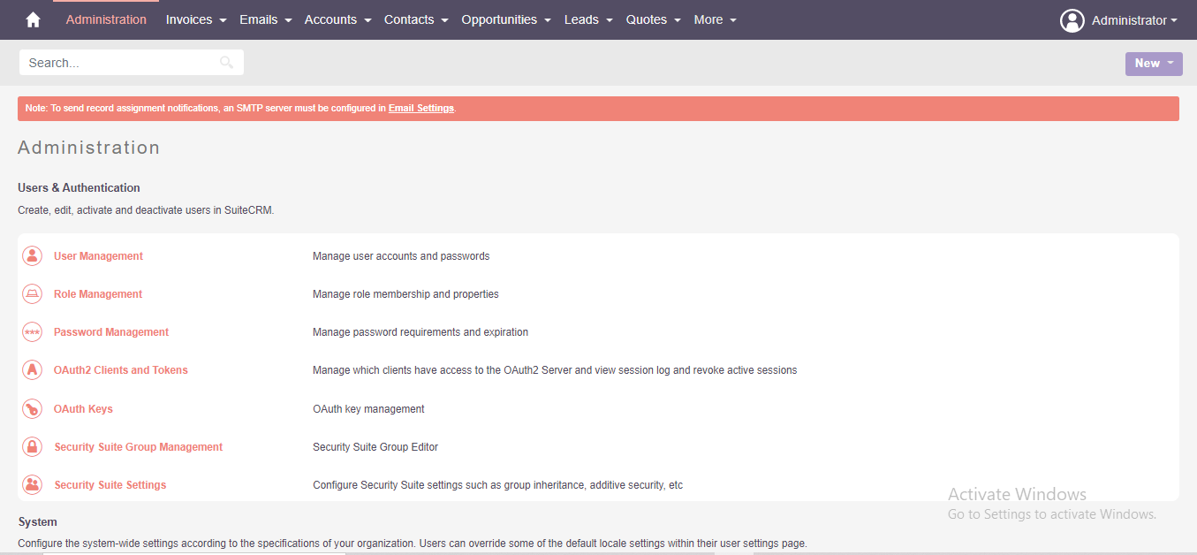
Step:-2
When Admin is open we will get a interface which is given below
Admin -> Studio

Slide 11
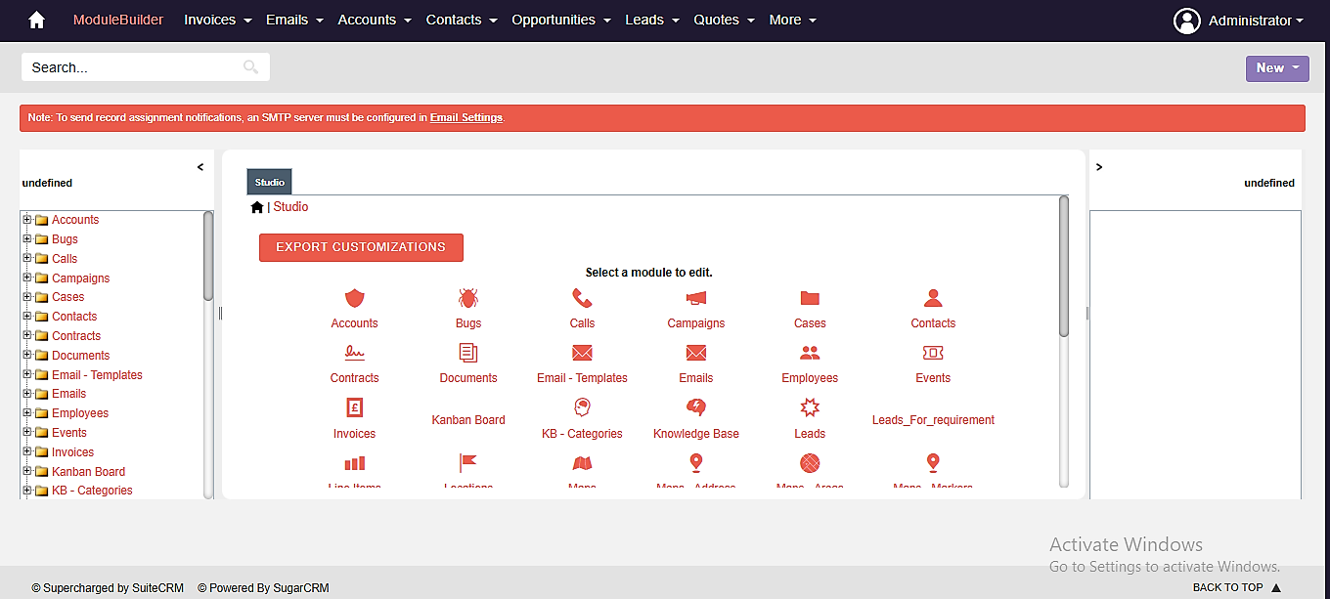
Step:-3
Here we can select in which module we have to
make changes.
Studio -> Leads

Slide 12
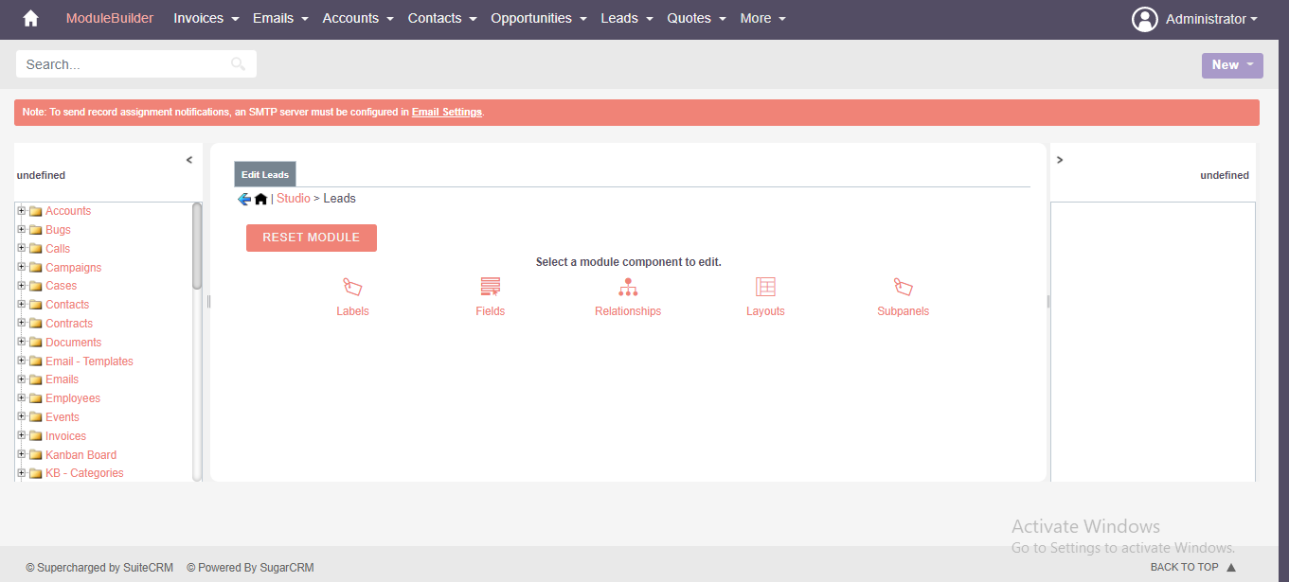
Step:-4
Here in Leads Module we change labels, Field ,relationship ,layouts.
It depend on user to change as per there requirement.

Slide 13
SuiteCRM For Orena
Creating form for Recruitment
In Recruitment , to create form the same procedure is follow as per given in Training.

Slide 14
References
Document No. | Document Title | Author
1 | Project Purpose & Requirements | Slideshare.net
2 | Policy Requirements | Google
3 | Error Debugging | Stack Overflow

Slide 15
THANK YOU.

